Slide 1

Exploratory Data Analysis ANZ
(Task 1)
From
Harpreet Singh Dhoot

Slide 2
Facts:
Average Transaction Amount is 187.69 AUD with approx. 4014 transactions/month.
There is a drastic dip on 16th of each month in number of transactions as avg Balance is also least on this date, that can be due to variety of reasons like EMI's are mostly done before or after 16th.
There is a dip at the end of month, which is understandable as saving would be less as compared to start of the month.
Balance grows linearly over the given course of time given in data I.e. August, September & October.
Unknown Merchants contribute the most amount I.e. 19,53,418 so, track has to be kept on them.
According to available data, Merchant States contribution in total amount is as shown:
NSW > VIC > QLD > WA > SA > NT > ACT > TAS in order of total amount or no. of transaction.
(Number of Transaction is Directly Proportional to Total Amount in a State)

Slide 3
Data In Respect To Gender
Males have upper hand in the balance as well as amount or number of transaction section as compared to females
Stats :-
Males are 6,258 and females are 5,758 in total.
Males - 12.92.962/10,76,33,889 vs Females - 9,70,323/6,94,48,738 (Total Amount/Balance)
Males are leading in transaction on merchant states like NSW ,VIC, ACT, TAS.
While, Females leading in SA, NT, Queens, WA.
According to this facts, further steps can be considered.

Slide 4
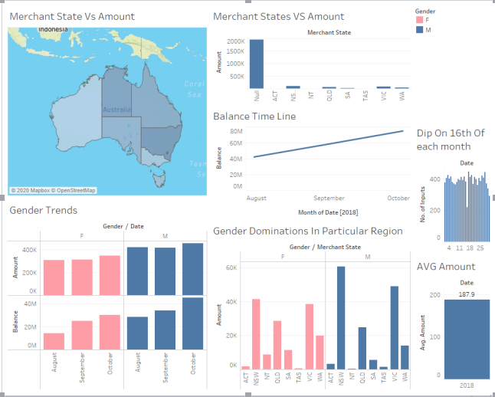
Visualizations (Tableau)

Slide 5
Thanks!
.

